Slide 1
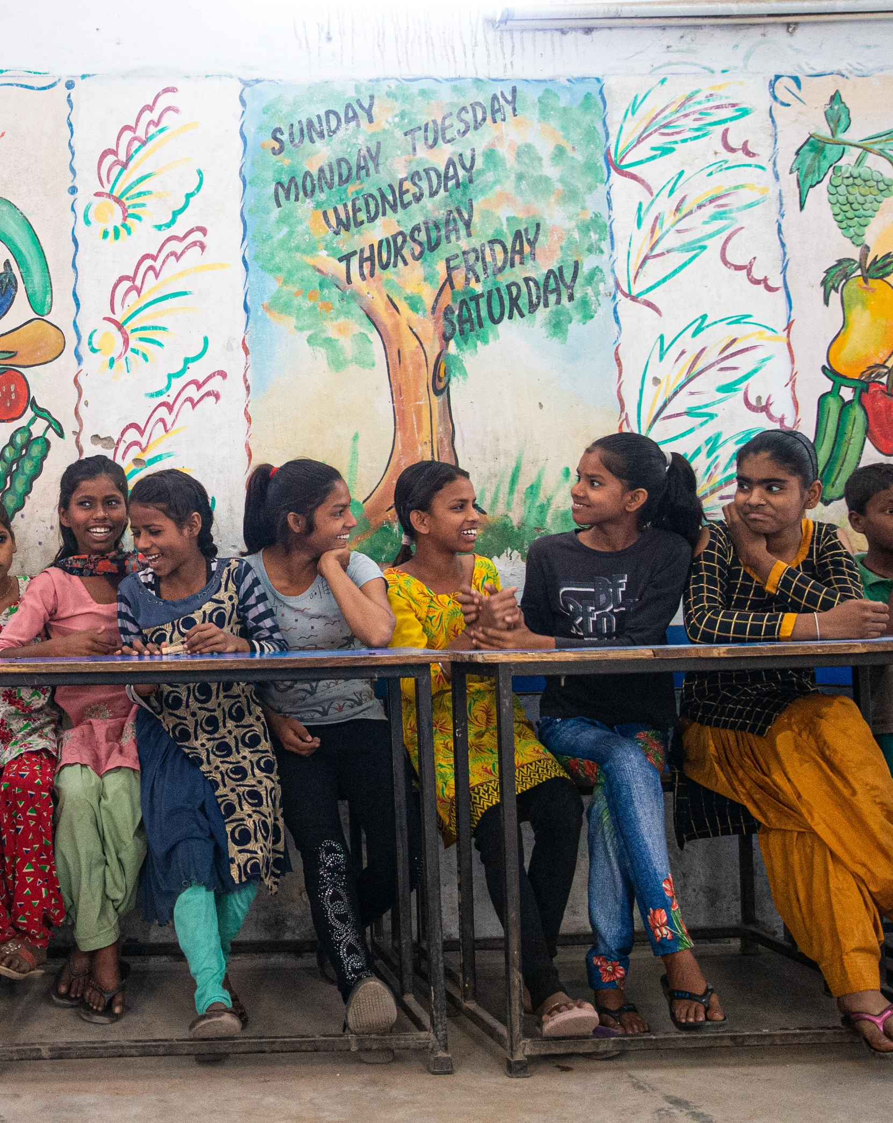


Open Education Analytics
Module Creation Kit - Creating Visualizations

Slide 2





Ingest
Ensure Privacy
Transform
& Enrich
Explore
Visualize
Insert Module Analysis Outcome
Insert Type of Data Used for Module
PowerBI
PowerBI
Insert Module Dashboard Screenshot
Insert Name of Table(s) used from the Data Source
Azure Synapse
stage 1
(bronze)
stage 2
(silver)
Notes:
General Module Creation Overview Visual (used for the landing page of the module README.md)

Slide 3

1
2
3
4
Get Started with the Modern Data Estate
Identify OEA Assets based on Use Case
Develop and Deploy Use Case Solution
Share extensions with OEA Community
Insert the Name of the Module
1
2
3
4
Insert Step 1
Insert Step 2
Insert Step 3
Insert Step 4
5
6
Insert Step 5
Insert Step 6
Notes:
General Module Creation Setup Instructions Visual (used for the landing page of the module README.md). Aim to make each step in this visual as concise as possible and try to use as little steps as possible.

